Slide 1
Network Security Chapter 8
Cryptography
Symmetric-Key Algorithms
Public-Key Algorithms
Digital Signatures
Management of Public Keys
Communication Security
Authentication Protocols
Email Security
Web Security
Social Issues
Revised: August 2011
Notes:
Gray units can be optionally omitted without causing later gaps

Slide 2
Network Security
Security concerns a variety of threats and defenses across all layers
Application
Transport
Network
Link
Physical

Slide 3
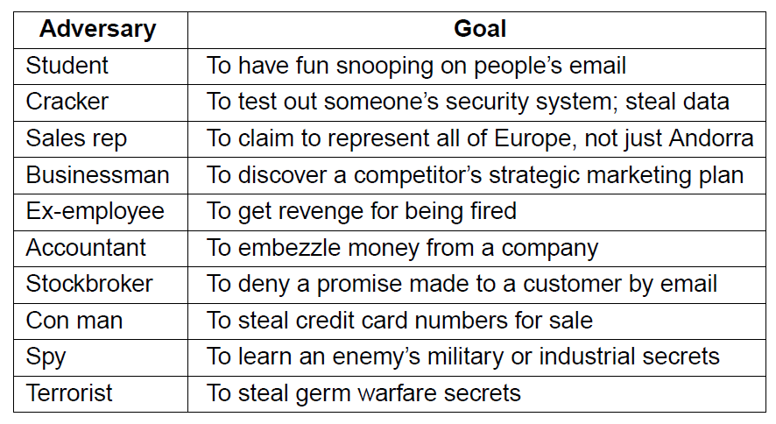
Network Security (1)
Some different adversaries and security threats
Different threats require different defenses

Slide 4
Cryptography
Cryptography is a fundamental building block for security mechanisms.
Introduction »
Substitution ciphers »
Transposition ciphers »
One-time pads »
Fundamental cryptographic principles »

Slide 5
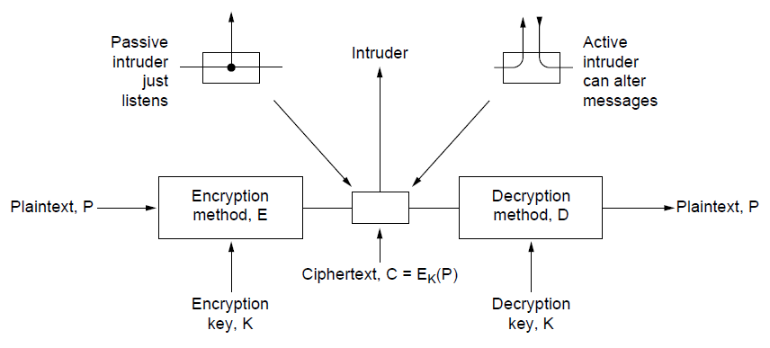
Introduction
The encryption model (for a symmetric-key cipher)
Kerckhoff’s principle: Algorithms (E, D) are public; only the keys (K) are secret
Trudy
Alice
Bob

Slide 6
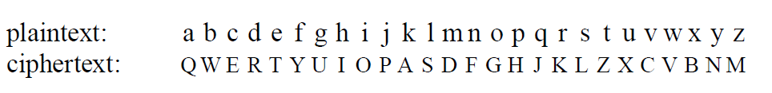
Substitution Ciphers
Substitution ciphers replace each group of letters in the message with another group of letters to disguise it
Simple single-letter substitution cipher

Slide 7
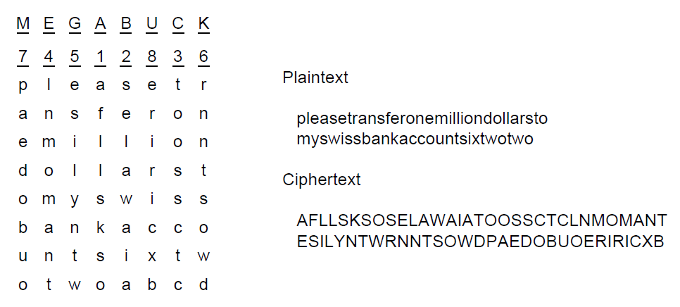
Transposition Ciphers
Transposition ciphers reorder letters to disguise them
Key gives column order
Column 5
6
7
8
Simple column transposition cipher

Slide 8
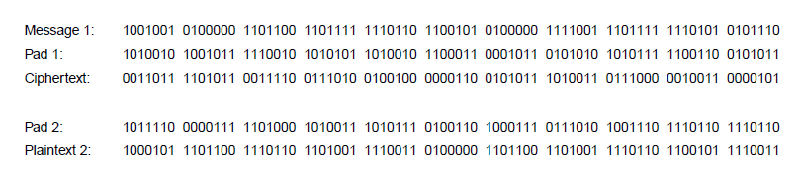
One-Time Pads (1)
Simple scheme for perfect secrecy:
XOR message with secret pad to encrypt, decrypt
Pad is as long as the message and can’t be reused!
It is a “one-time” pad to guarantee secrecy
Different secret pad decrypts to the wrong plaintext

Slide 9
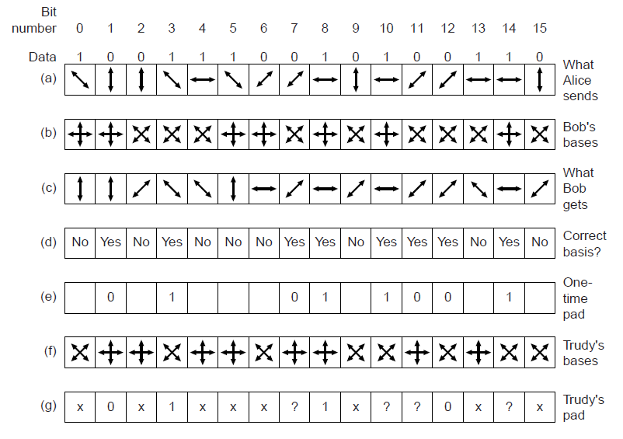
One-Time Pads (2)
Alice sending Bob a one-time pad with quantum crypto.
Bob’s guesses yield bits; Trudy misses some
Bob can detect Trudy since error rate increases

Slide 10
Fundamental Cryptographic Principles
Messages must contain some redundancy
All encrypted messages decrypt to something
Redundancy lets receiver recognize a valid message
But redundancy helps attackers break the design
Some method is needed to foil replay attacks
Without a way to check if messages are fresh then old messages can be copied and resent
For example, add a date stamp to messages

Slide 11
Symmetric-Key Algorithms
Encryption in which the parties share a secret key
DES – Data Encryption Standard »
AES – Advanced Encryption Standard »
Cipher modes »
Other ciphers »
Cryptanalysis »

Slide 12
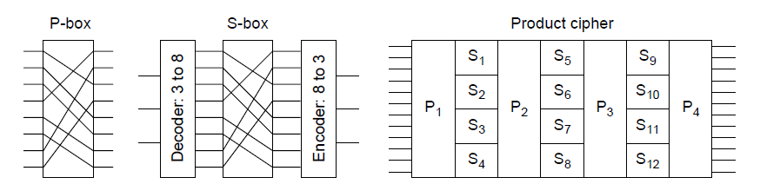
Symmetric-Key Algorithms (1)
Use the same secret key to encrypt and decrypt; block ciphers operate a block at a time
Product cipher combines transpositions/substitutions
Permutation
(transposition)
box
Substitution
box
Product with multiple P- and S-boxes

Slide 13
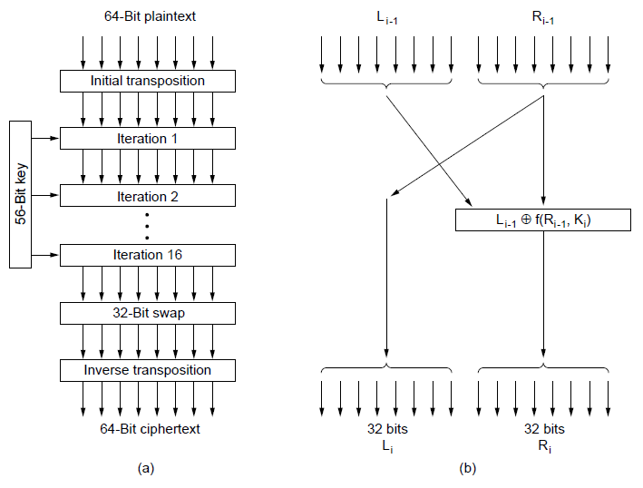
Data Encryption Standard (1)
DES encryption was widely used (but no longer secure)
Contains
transpositions & substitutions
DES steps
A single iteration

Slide 14
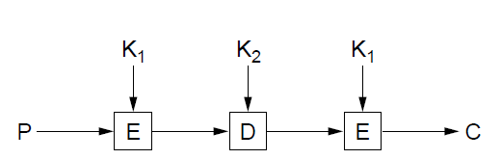
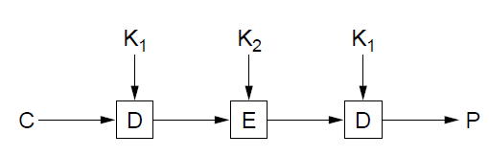
Data Encryption Standard (2)
Triple encryption (“3DES”) with two 56-bit keys
Gives an adequate key strength of 112 bits
Setting K₁ = K₂ allows for compatibility with DES
Triple DES encryption
Triple DES decryption

Slide 15
Advanced Encryption Standard (1)
AES is the successor to DES:
Symmetric block cipher, key lengths up to 256 bits
Openly designed by public competition (1997-2000)
Available for use by everyone
Built as software (e.g., C) or hardware (e.g., x86)
Winner was Rijndael cipher
Now a widely used standard

Slide 16
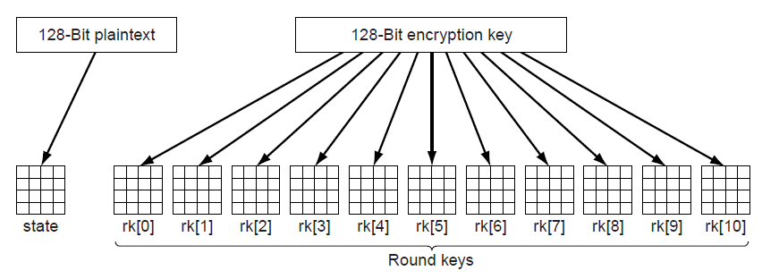
Advanced Encryption Standard (2)
AES uses 10 rounds for 128-bit block and 128-bit key
Each round uses a key derived from 128-bit key
Each round has a mix of substitutions and rotations
All steps are reversible to allow for decryption
Round keys are derived from 128-bit secret key

Slide 17
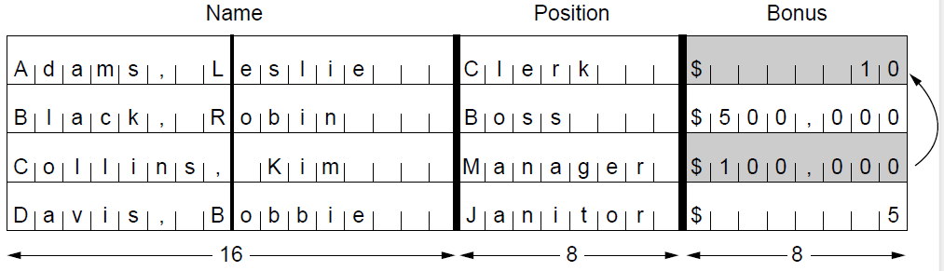
Cipher Modes (1)
Cipher modes set how long messages are encrypted
Encrypting each block independently, called ECB (Electronic Code Book) mode, is vulnerable to shifts
With ECB mode, switching encrypted blocks gives a different but valid message
Leslie gets a large bonus!

Slide 18
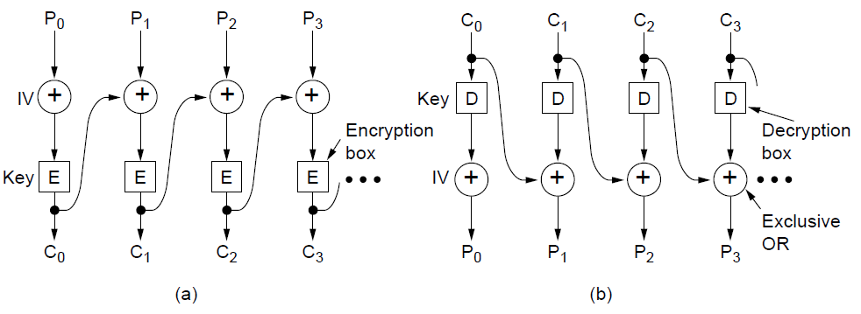
Cipher Modes (2)
CBC (Cipher Block Chaining) is a widely used mode
Chains blocks together with XOR to prevent shifts
Has a random IV (Initial Value) for different output
CBC mode encryption
CBC mode decryption
Notes:
Because of the IV, repeated encryptions of the same message will produce different ciphertext.

Slide 19
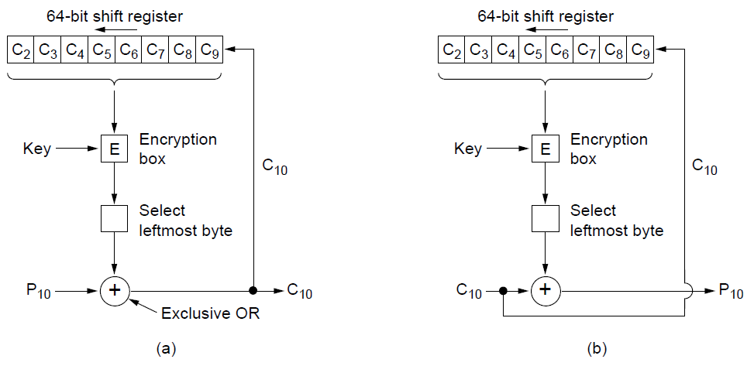
Cipher Modes (3)
There are many other modes with pros / cons, e.g., cipher feedback mode is similar to CBC mode but can operate a byte (rather than a whole block) at a time
Encryption
Decryption

Slide 20
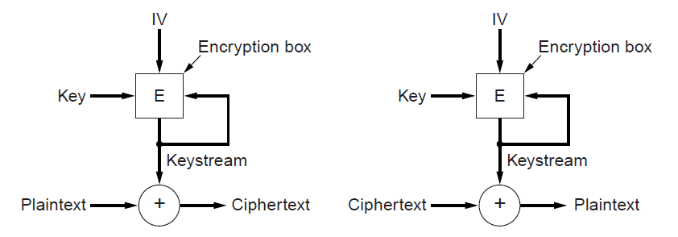
Cipher Modes (4)
A stream cipher uses the key and IV to generate a stream that is a one-time pad; can’t reuse (key, IV) pair
Doesn’t amplify transmission errors like CBC mode
Encryption
Decryption

Slide 21
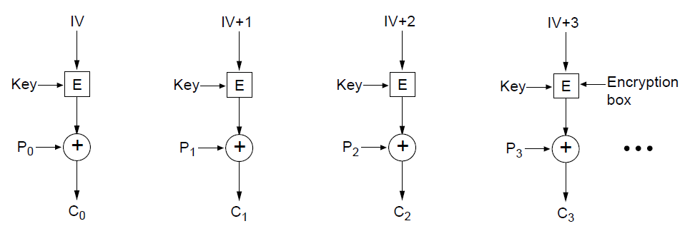
Cipher Modes (5)
Counter mode (encrypt a counter and XOR it with each message block) allows random access for decryption
Encryption above; repeat the operation to decrypt

Slide 22
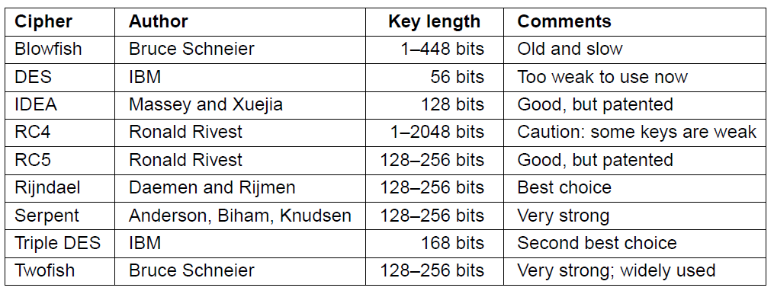
Other Ciphers
Some common symmetric-key cryptographic algorithms
Can be used in combination, e.g., AES over Twofish

Slide 23
Public-Key Algorithms
Encryption in which each party publishes a public part of their key and keep secret a private part of it
RSA (by Rivest, Shamir, Adleman) »

Slide 24
Public-Key Algorithms (1)
Downsides of keys for symmetric-key designs:
Key must be secret, yet be distributed to both parties
For N users there are N² pairwise keys to manage
Public key schemes split the key into public and private parts that are mathematically related:
Private part is not distributed; easy to keep secret
Only one public key per user needs to be managed
Security depends on the chosen mathematical property
Much slower than symmetric-key, e.g., 1000X
So use it to set up per-session symmetric keys

Slide 25
RSA (1)
RSA is a widely used public-key encryption method whose security is based on the difficulty of factoring large numbers
Key generation:
Choose two large primes, p and q
Compute n = p × q and z = ( p − 1) × (q − 1).
Choose d to be relatively prime to z
Find e such that e × d = 1 mod z
Public key is (e, n), and private key is (d, n)
Encryption (of k bit message, for numbers up to n):
Cipher = Plain^{e} (mod n)
Decryption:
Plain = Cipher^{d} (mod n)

Slide 26
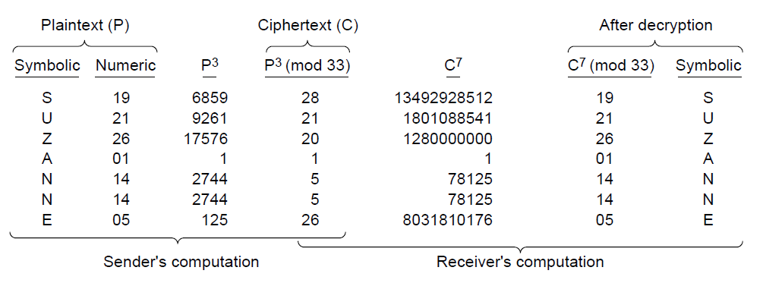
RSA (2)
Small-scale example of RSA encryption
For p=3, q=11 → n=33, z=20 → d=7, e=3
Encryption: C = P³ mod 33
Decryption: P = C⁷ mod 33

Slide 27
Digital Signatures
Lets receiver verify the message is authentic
Symmetric-Key signatures »
Public-Key signatures »
Message digests »
The birthday attack »

Slide 28
Digital Signatures (1)
Requirements for a signature:
Receiver can verify claimed identity of sender.
Sender cannot later repudiate contents of message.
Receiver cannot have concocted message himself.

Slide 29
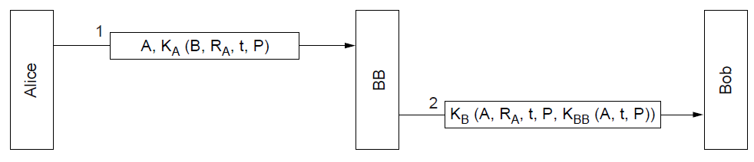
Symmetric-key Signatures
Alice and Bob each trust and share a key with Big Brother; Big Brother doesn’t trust anyone
A=Alice, B=Bob, P=message, R_{A}=random, t=time
Only Alice can send this encrypted message to BB
Only BB can send this encrypted message to Bob
Notes:
RA and time protect against replays. Time lets very old messages be detected. For recent messages, RA can be checked to see if it has been used before.

Slide 30
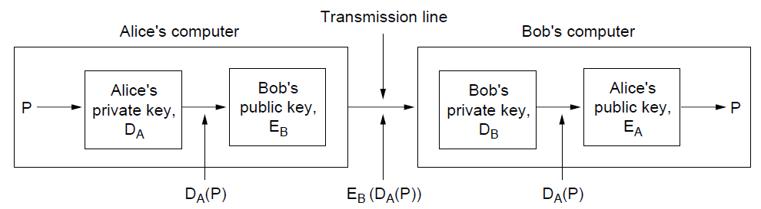
Public-Key Signatures
No Big Brother and assumes encryption and decryption are inverses that can be applied in either order
But relies on private key kept and secret
RSA & DSS (Digital Signature Standard) widely used

Slide 31
Message Digests (1)
Message Digest (MD) converts arbitrary-size message (P) into a fixed-size identifier MD(P) with properties:
Given P, easy to compute MD(P).
Given MD(P), effectively impossible to find P.
Given P no one can find P′ so that MD(P′) = MD(P).
Changing 1 bit of P produces very different MD.
Message digests (also called cryptographic hash) can “stand for” messages in protocols, e.g., authentication
Example: SHA-1 160-bit hash, widely used
Example: MD5 128-bit hash – now known broken

Slide 32
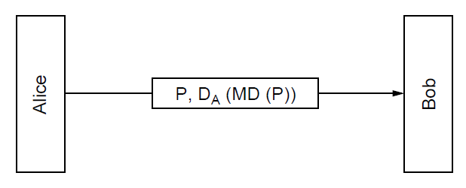
Message Digests (2)
Public-key signature for message authenticity but not confidentiality with a message digest
Message sent in the clear
Alice signs
message digest

Slide 33
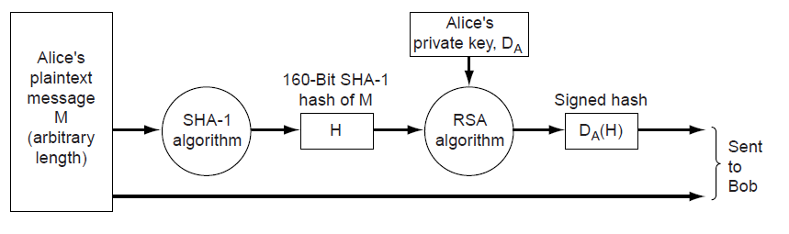
Message Digests (3)
In more detail: example of using SHA-1 message digest and RSA public key for signing nonsecret messages

Slide 34
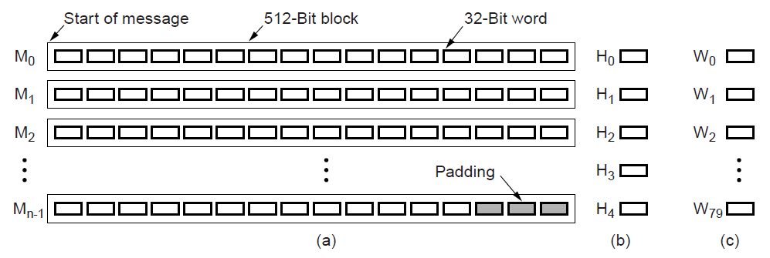
Message Digests (4)
SHA-1 digests the message 512 bits at a time to build a 160-bit hash as five 32-bit components
SHA-1
Message in 512-bit blocks
Five 32-bit hashes output

Slide 35
Birthday Attack
How hard is it to find a message P′ that has the same message digest as P?
Such a collision will allow P′ to be substituted for P!
Analysis:
N bit hash has 2^{N} possible values
Expect to test 2^{N} messages given P to find P′
But expect only 2^{N/2} messages to find a collision
This is the birthday attack

Slide 36
Management of Public Keys
We need a trusted way to distribute public keys
Certificates »
X.509, the certificate standard »
Public Key infrastructures »

Slide 37
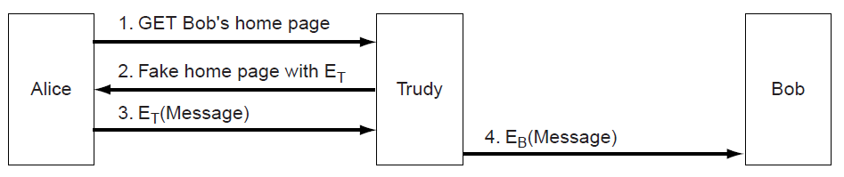
Management of Public Keys (1)
Trudy can subvert encryption if she can fake Bob’s public key; Alice and Bob will not necessarily know
Trudy replaces E_{B} with E_{T} and acts as a “man in the middle”

Slide 38
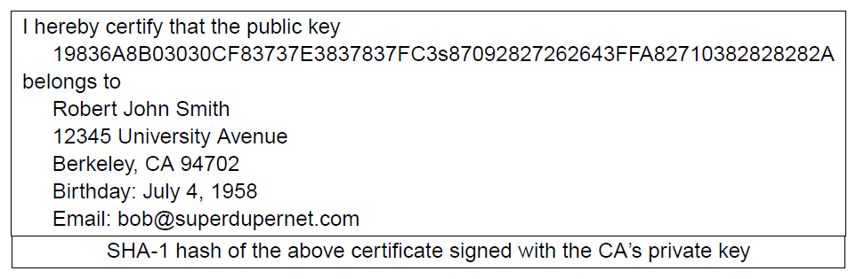
Certificates
CA (Certification Authority) issues signed statements about public keys; users trust CA and it can be offline
A possible certificate

Slide 39
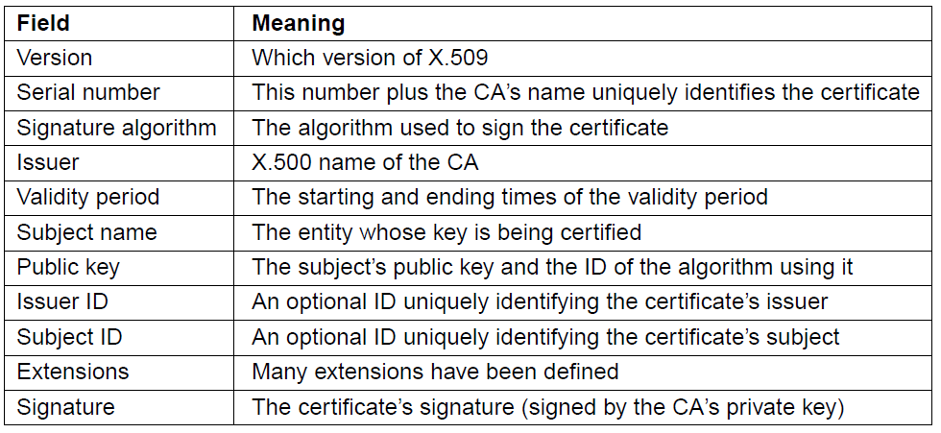
X.509
X.509 is the standard for widely used certificates
Ex: used with SSL for secure Web browsing
Basic fields in X.509 certificates

Slide 40
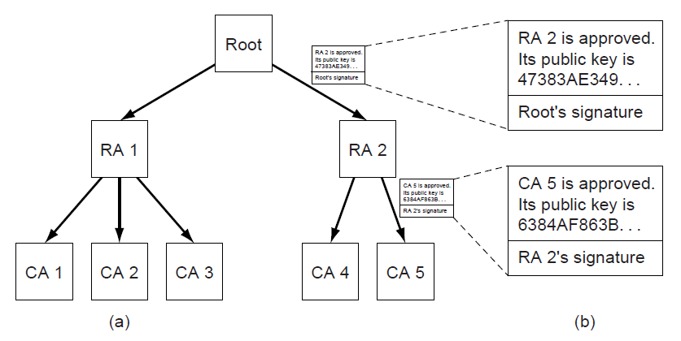
Public Key Infrastructures (PKIs)
PKI is a system for managing public keys using CAs
Scales with hierarchy, may have multiple roots
Also need CRLs (Certificate Revocation Lists)
Trust anchor
Chain of certificates for CA 5
Hierarchical PKI

Slide 41
Communication Security
Applications of security to network protocols
IPsec (IP security) »
Firewalls »
Virtual private networks »
Wireless security »

Slide 42
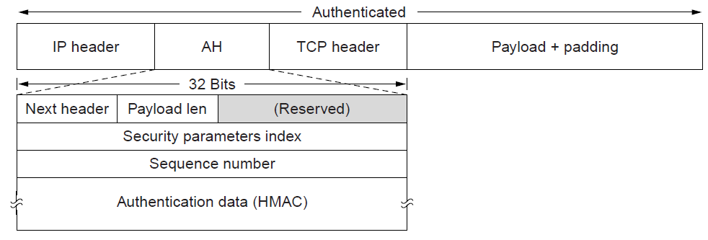
IPsec (1)
IPsec adds confidentiality and authentication to IP
Secret keys are set up for packets between endpoints called security associations
Adds AH header; inserted after IP in transport mode
Identifies security association
AH (Authentication Header) provides integrity and anti-replay

Slide 43
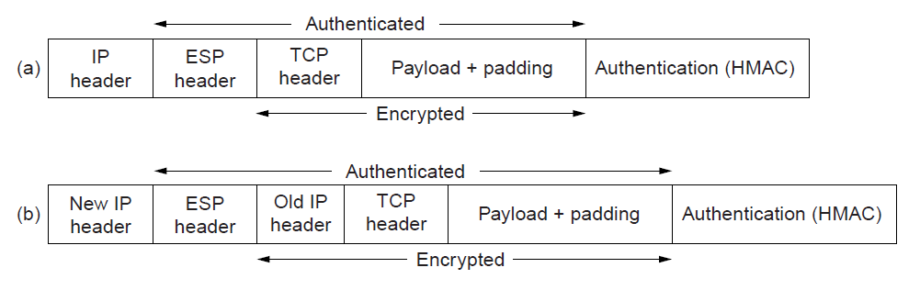
IPsec (2)
ESP (Encapsulating Security Payload) provides secrecy and integrity; expands on AH
Adds ESP header and trailer; inserted after IP header in transport or before in tunnel mode
Transport mode
Tunnel mode
Whole IP packet is wrapped

Slide 44
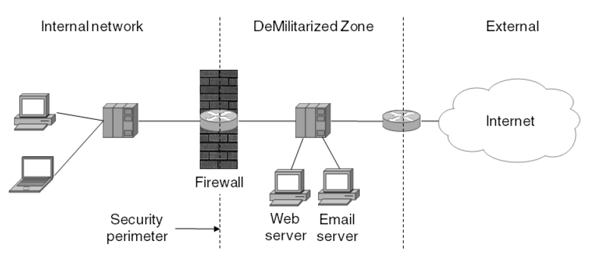
Firewalls
A firewall protect an internal network by filtering packets
Can have stateful rules about what packets to pass
E.g., no incoming packets to port 80 (Web) or 25 (SMTP)
DMZ helps to separate internal from external traffic
E.g., run Web and Email servers there
DMZ
(DeMilitarized Zone)

Slide 45
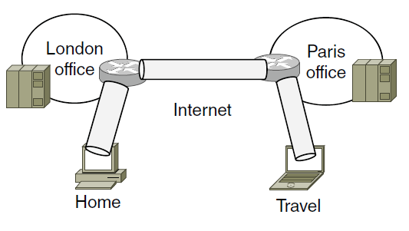
Virtual Private Networks (1)
VPNs (Virtual Private Networks) join disconnected islands of a logical network into a single virtual network
Islands are joined by tunnels over the Internet
Tunnel
VPN joining London, Paris, Home, and Travel

Slide 46
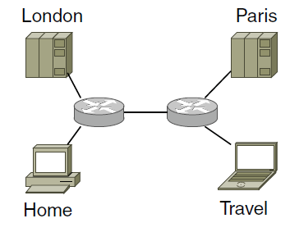
Virtual Private Networks (2)
VPN traffic travels over the Internet but VPN hosts are separated from the Internet
Need a gateway to send traffic in/out of VPN
Topology as seen from inside the VPN

Slide 47
Wireless Security (1)
Wireless signals are broadcast to all nearby receivers
Important to use encryption to secure the network
This is an issue for 802.11, Bluetooth, 3G, …
Common design:
Clients have a password set up for access
Clients authenticate to infrastructure and set up a session key
Session key is then used to encrypt packets

Slide 48
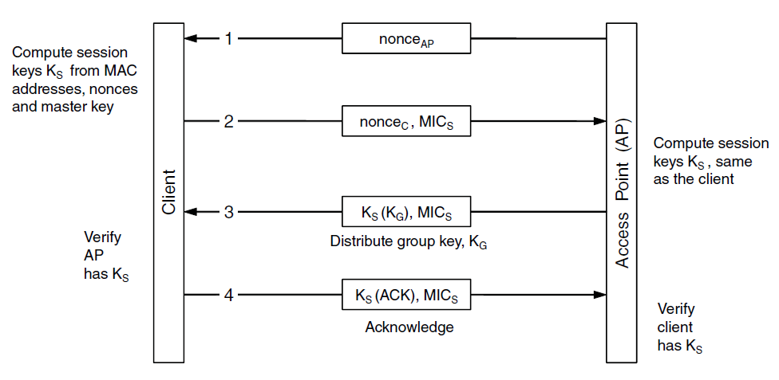
Wireless Security (2)
802.11i session key setup handshake (step 2)
Client and AP share a master key (password)
MIC (Message Integrity Check) is like a signature
K_{X}(M) means a message M encrypted with key K_{X}

Slide 49
Authentication Protocols
Authentication verifies the identity of a remote party
Shared Secret Key »
Diffie-Hellman Key Exchange »
Key Distribution Center »
Kerberos »
Public-Key Cryptography »

Slide 50
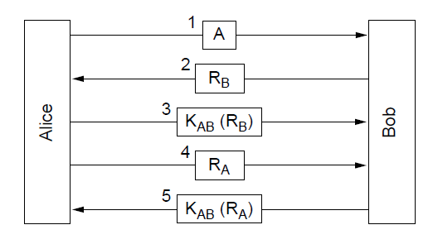
Shared Secret Key (1)
Authenticating with a challenge-response (first attempt)
Alice (A) and Bob (B) share a key K_{AB}
R_{X} is random, K_{X} (M) is M encrypted with key K_{X}
Challenge
Response
Bob knows it’s Alice
Alice knows it’s Bob

Slide 51
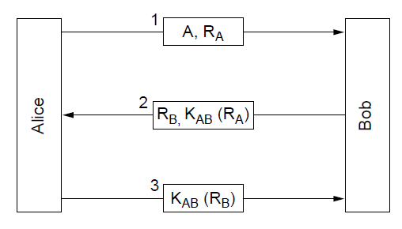
Shared Secret Key (2)
A shortened two-way authentication (second attempt)
But it is vulnerable to reflection attack

Slide 52
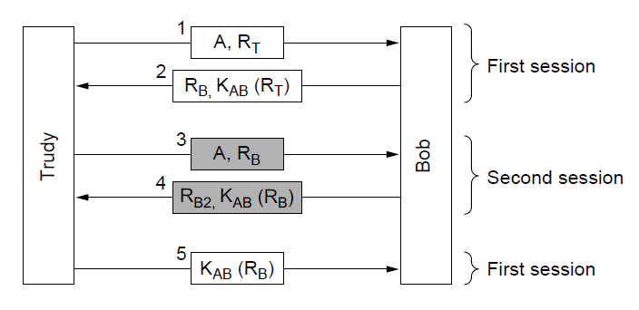
Shared Secret Key (3)
Trudy impersonates Alice to Bob with reflection attack
Second session gets Bob to give Trudy the response
Bob thinks he is talking to Alice now

Slide 53
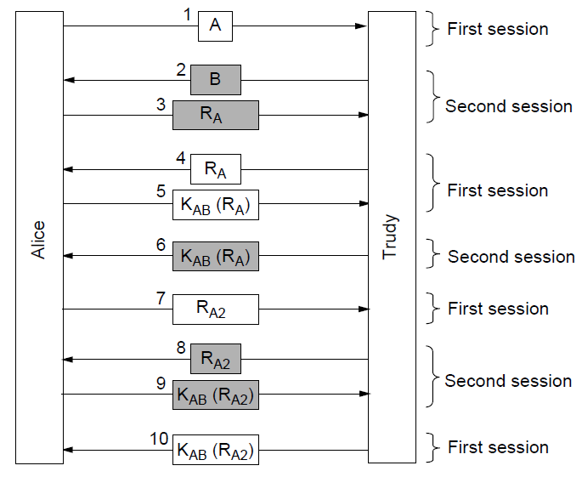
Shared Secret Key (4)
First attempt is also vulnerable to reflection attack!
Trudy impersonates Bob to Alice after Alice initiates
Alice thinks she is talking to Bob
Alice thinks she is talking to Bob again

Slide 54
Shared Secret Key (5)
Moral: Designing a correct authentication protocol is harder than it looks; errors are often subtle.
General design rules for authentication:
Have initiator prove who she is before responder
Initiator, responder use different keys
Draw challenges from different sets
Make protocol resistant to attacks involving second parallel session

Slide 55
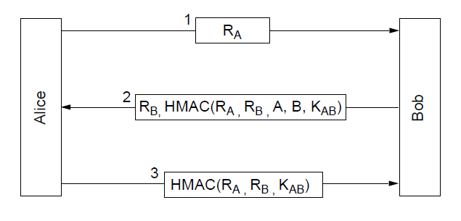
Shared Secret Key (6)
An authentication protocol that is not vulnerable
HMAC (Hashed Message Authentication Code) is an authenticator, like a signature
Alice knows it’s Bob
Bob knows it’s Alice

Slide 56
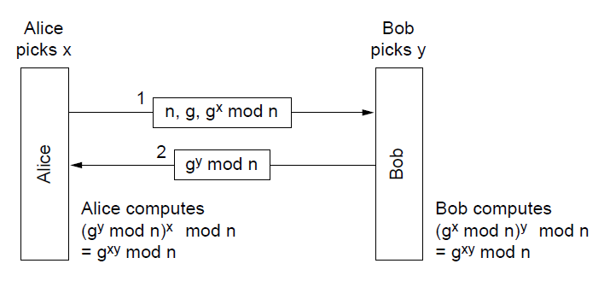
Diffie-Hellman Key Exchange (1)
Lets two parties establish a shared secret
Eavesdropper can’t compute secret g^{xy} mod n without knowing x or y
Shared secret
Shared secret

Slide 57
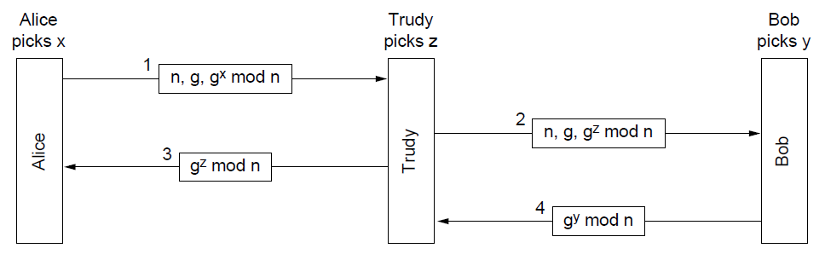
Diffie-Hellman Key Exchange (2)
But it is vulnerable to a man-in-the-middle attack
Need to confirm identities, not just share a secret
g^{xz} mod n
g^{xz} mod n
g^{zy} mod n
g^{zy} mod n

Slide 58
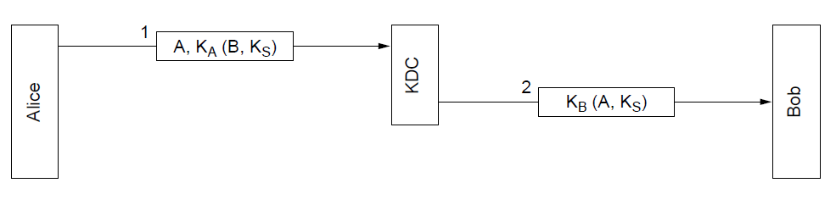
KDC – Key Distribution Center (1)
Trusted KDC removes need for many shared secrets
Alice and Bob share a secret only with KDC (K_{A}, K_{B})
End up with K_{S}, a shared secret session key
First attempt below is vulnerable to replay attack in which Trudy captures and later replays messages
Trudy can send this later to impersonate Alice to Bob
Bob has session key K_{S}
Alice has session key K_{S}

Slide 59
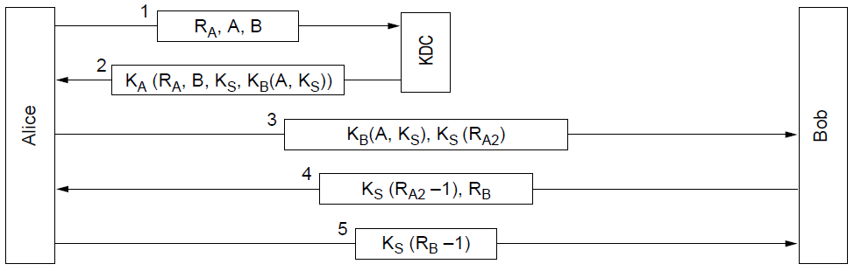
Key Distribution Center (2)
The Needham-Schroeder authentication protocol
Not vulnerable to replays; doesn’t use timestamps
Alice knows it’s Bob
Bob knows it’s Alice

Slide 60
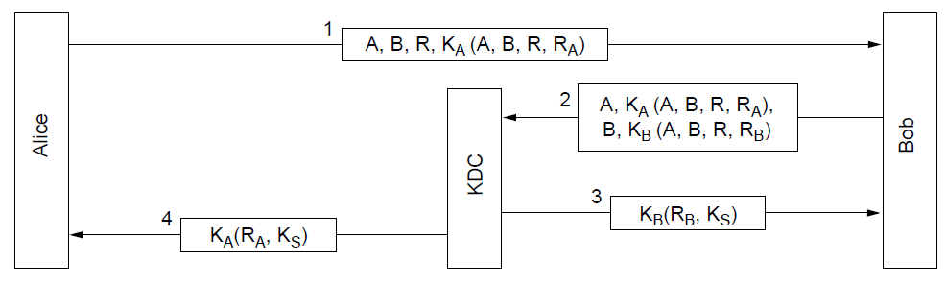
Key Distribution Center (3)
The Otway-Rees authentication protocol (simplified)
Slightly stronger than previous; Trudy can’t replay even if she obtains previous secret K_{S}

Slide 61
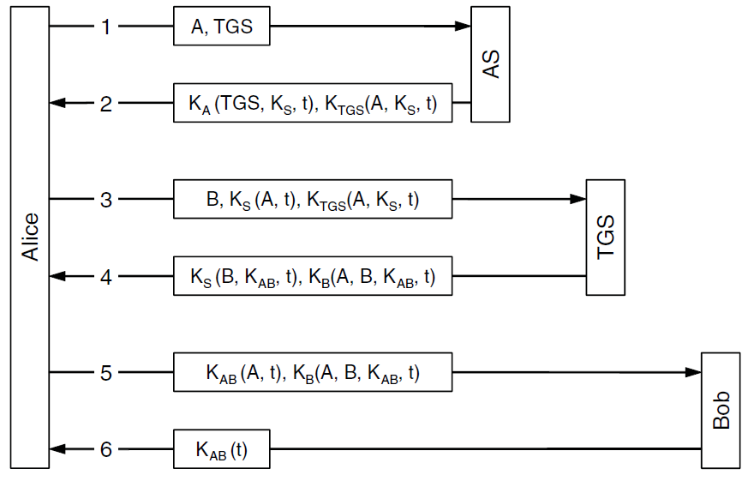
Kerberos
Kerberos V5 is a widely used protocol (e.g., Windows)
Authentication includes TGS (Ticket Granting Server)
Ticket
Gets session key K_{S}
Alice asks for a secret shared with Bob
Ticket
Gets shared key K_{AB}
Knows it’s Alice
Bob gets key K_{AB}
Knows it’s Bob
Notes:
The timestamps, t, are used to weed out very old messages

Slide 62
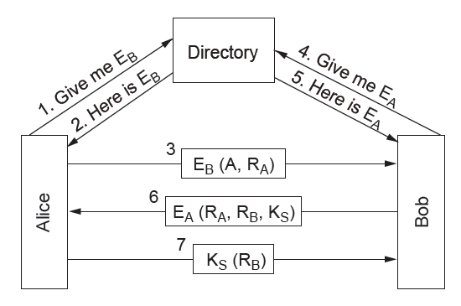
Public-Key Cryptography
Mutual authentication using public-key cryptography
Alice and Bob get each other’s public keys (E_{A}, E_{B}) from a trusted directory; shared K_{S} is the result

Slide 63
Email Security
Use of security for authenticated, confidential email
PGP—Pretty Good Privacy »

Slide 64
PGP—Pretty Good Privacy (1)
PGP uses public- and symmetric-key cryptography for email secrecy and signatures; it also manages keys
Levels of public-key strengths:
Casual (384 bits):
Can be broken easily today.
Commercial (512 bits): b
Breakable by three-letter organizations.
Military (1024 bits):
Not breakable by anyone on earth.
Alien (2048 bits):
Unbreakable by anyone on other planets

Slide 65
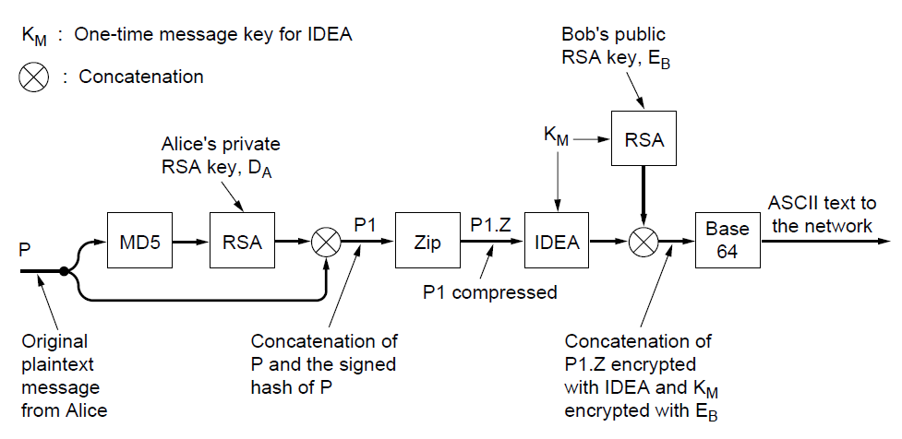
PGP—Pretty Good Privacy (2)
Signing and encrypting a message from Alice to Bob
For speed, message symmetric-key IDEA encrypted with K_{M}; K_{M} is RSA public-key encrypted with K_{B}
Authentication
Confidentiality

Slide 66
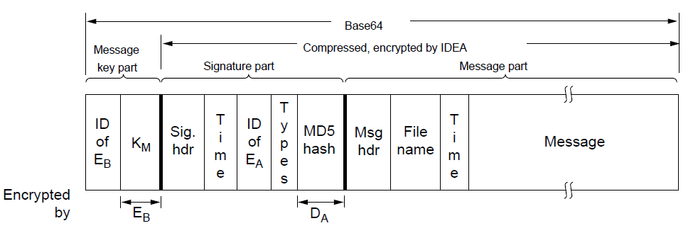
PGP—Pretty Good Privacy (3)
Three parts of a PGP message and their encryption:
PGP also manages public keys for a user:
Private key ring has user’s public/private keys
Public key ring has correspondent’s public keys
K_{M}

Slide 67
Web Security
Applications of security to the Web
Secure naming »
SSL—Secure Sockets Layer »
Many other issues with downloaded code

Slide 68
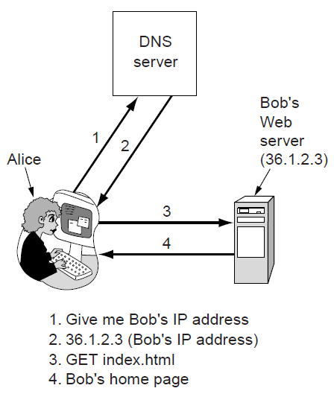
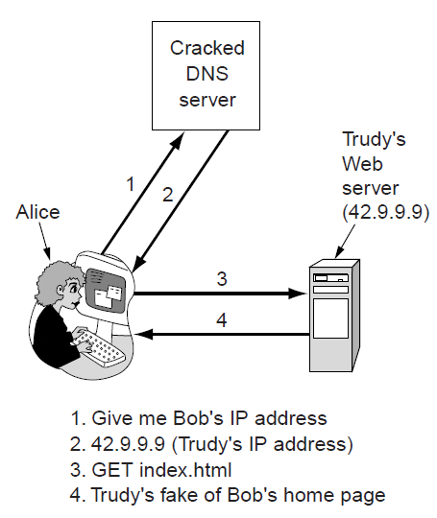
Secure Naming (1)
DNS names are included as part of URLs – so spoofing DNS resolution causes Alice contact Trudy not Bob
Trudy sends spoofed reply

Slide 69
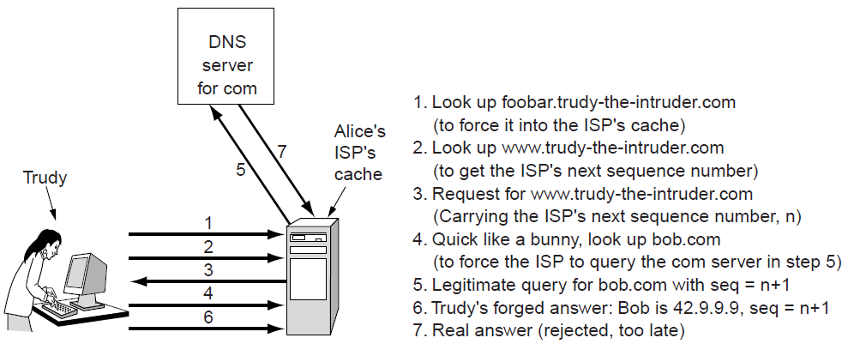
Secure Naming (2)
How Trudy spoofs the DNS for bob.com in more detail
To counter, DNS servers randomize seq. numbers
DNS cache at Alice’s ISP

Slide 70

Secure Naming (3)
DNSsec (DNS security) adds strong authenticity to DNS
Responses are signed with public keys
Public keys are included; client starts with top-level
Also optional anti-spoofing to tie request/response
Now being deployed in the Internet
Resource Record set for bob.com.
Has Bob’s public key (KEY), and is signed by .com server (SIG)
Notes:
Bob’s public key can be used in the future to check the authenticity of responses for machines within bob.com.

Slide 71

SSL—Secure Sockets Layer (1)
SSL provides an authenticated, secret connection between two sockets; uses public keys with X.509
TLS (Transport Layer Security) is the IETF version
SSL runs on top of TCP and below
the application
HTTPS means
HTTP over SSL
SSL in the protocol stack

Slide 72

SSL—Secure Sockets Layer (2)
Phases in SSL V3 connection establishment (simplified)
Only the client (Alice) authenticates the server (Bob)
Session key computed on both sides (E_{B}, R_{A}, R_{B})

Slide 73

SSL—Secure Sockets Layer (3)
Data transmission using SSL. Authentication and encryption for a connection use the session key.

Slide 74
Social Issues
Networks give rise to many social issues
Privacy »
Freedom of speech »

Slide 75

Privacy
Anonymous remailers hide the identity of the sender
Unlike PGP, which only hides message contents
A chain can be used for stronger anonymity
Alice looks up keys E1, E2, E3 separately
Bob gets a very anonymous mail

Slide 76

Freedom of Speech
Steganography hides messages on unrelated content
Can help avoid censorship or protect ownership
Text hidden in low-order bits
“Three zebras and a tree”
“Three zebras and a tree,” with five plays by Shakespeare”

Slide 77
End
Chapter 8

